Slide 1
Full Offering
The more your offering fills your customer’s needs, the less likely it is for your customer to go to a competitor.

Slide 2
What Is An Offering?
Offering
Products
Services
Intellectual Property

Slide 3
The Goal
Make your product or service more desirable to your customer.

Slide 4
Key Points
Describe your customer
Describe your product or service
Brainstorm other customer needs or wants
Brainstorm unique ways to fill these other needs or wants
Example
What not to do
Your next steps
Wrap up

Slide 5
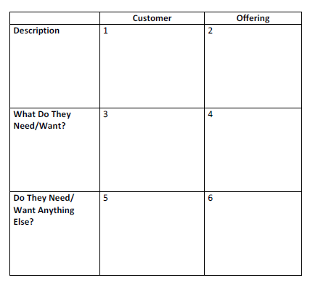
Worksheet
Grab your worksheet and follow along.

Slide 6
Brainstorming Time!

Slide 7
Customer Description

Slide 8
Offering Description

Slide 9
Customer -What Do They Need/Want?

Slide 10
How To Deliver?

Slide 11
Customer -What Do They Need/Want?

Slide 12
How To Deliver?

Slide 13
How Does It Work?
 | Customer | Offering
Describe | Family-oriented consumers that enjoy socializing and enjoy food. Common goals are saving time from cooking and spending it with family while being cost conscious. | A variety of Italian dishes for a full meal from appetizer to dessert together with alcoholic and non-alcoholic drinks Affordable prices, with items priced higher than “fast-food” restaurants but lower than “gourmet” restaurants A family-oriented atmosphere Time savings by not having to shop for and cook own meals
What Do They Need/Want? | Need a night off from cooking Need to save time associated with cooking/cleaning Want to have a meal together Reasonable price as they do not have a lot of disposable income | Offer a variety of dishes that range in prices to meet the needs of different consumers Offer a dining atmosphere that is relatively free of background noises (music, televisions) so that guests can converse easily Offer a children’s menu and give each child an activity pack with crayons to entertain them while at the restaurant
Do They Need/ Want Anything Else? | Want a meal that is prepared quickly because they have other time commitments especially with children Parents want to be waited upon and be treated like a VIP | Offer a quick-service menu of items that can be prepared within 15 minutes of ordering Offer take-out and delivery options Allow frequent customers to call ahead so that their food is ready when they arrive to eat Train staff to be focused on customer service and the customer’s experience Install “call” buttons so that restaurant patron can signal to wait staff that they need service

Slide 14
Top Mistakes To Avoid
Assuming that what you are doing is what they are actually looking for
Not changing
Not challenging the need that you are meeting
Not targeting a customer
Implementing everything at once
Not re-evaluating consistently

Slide 15
Now What?
You know what your customers want so now be creative.
Implement the parts of the offering that will add the most to your customer’s experience.
Evaluate which have had the most positive impact on your business
Continuously try to improve upon this.
Identify a second target market and create a slightly different offering

Slide 16
Key Points
Describe your customer
Describe your product or service
Brainstorm other customer needs or wants
Brainstorm unique ways to fill these other needs or wants
Example
What not to do
Your next steps
Wrap up

Slide 17
The Goal
Make your product or service more desirable to your customer.

Slide 18
When you fulfill a customer’s need completely, they will never leave you.

