Slide 1
Finding Your First Customer
The first one is the toughest.

Slide 2
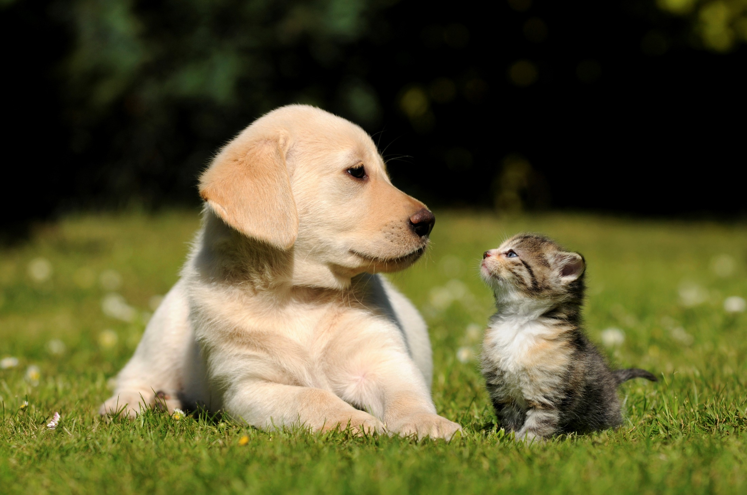
Customers & dogs can both smell fear.

Slide 3
The Goal
Focus on what to improve in your sales technique.

Slide 4
Key Points
Creating the right impression
Talking to the right people
Example
What not to do
Your next steps
Wrap up

Slide 5
Worksheet
Grab your worksheet and follow along.

Slide 6
Creating the right First impression

Slide 7
Confidence

Slide 8
Capability

Slide 9
Connection

Slide 10
Talking to the right people

Slide 11
Qualified

Slide 12
Interested

Slide 13
Ready

Slide 14
Quick Conclusion

Slide 15
How Does It Work?
Creating The Right Impression |  | Talking to the Right People
Confidence (interior) | 17/20 | Qualified | 25/30
Capability (exterior) | 6/10 | Interested | 7/10
Connection | 17/20 | Ready | 7/10
Score | 40/50 | Score | 39/50
Total – 79/100

Slide 16
Top Mistakes To Avoid
Continuing with what you are doing if you aren’t closing sales.
Neglecting any or one of these criteria.
Thinking that just a good product or service will sell itself.
Expecting that someone who says that they will buy will actually buy.
Giving up on a customer without trying.
Not asking for the sale.

Slide 17
Now What?
Focus on improving your greatest weakness
Continue to raise your expertise to stay competitive
Utilize everyone in your organization
Analyze your strategy

Slide 18
Key Points
Creating the right impression
Talking to the right people
Example
What not to do
Your next steps
Wrap up

Slide 19
The Goal
Focus on what to improve in your sales technique.

Slide 20
Having confidence in yourself is the first step to closing a sale.

