Slide 1

Finding Good Suppliers & Partners To Do Business With
Your people are an extension of you.

Slide 2

They need to be a good fit!

Slide 3

The Goal
Know the strategic relationships that need to be formed.

Slide 4

Key Points
What is a supplier?
Business requirements
Provider must-haves
Example
What not to do
Your next steps
Wrap up

Slide 5

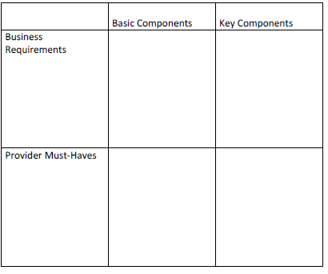
Worksheet
Grab your worksheet and follow along.

Slide 6

What is a supplier?

Slide 7

Business Requirements:
Basic Components

Slide 8

Business Requirements:
Key Components

Slide 9

Provider Must-Haves:
Basic Components

Slide 10

Provider Must-Haves:
Key Components

Slide 11
How Does It Work?
 | Basic Components | Key Components
Business Requirements | Billing Webpage | Tools Furnaces
Provider Must-Haves | Billing must be mobile and have ability to print invoices at the customer’s home. Webpage must have a map and be easy enough for me to update if my contact information changes. | Tools cannot break, must have good warranty, must offer full range of furnace tools, all size of tools, tools must be easily portable. Furnace company must have a furnace powerful enough to heat four to six-bedroom homes, must have full warranty, quality components, be energy efficient, have gas/oil options, have monthly condensed billing.

Slide 12

Top Mistakes To Avoid
Spending too much time looking for providers
Signing up with the first provider
Not actively seeking out partners
Forgetting your values and vision
Not considering at least 2 different suppliers

Slide 13

Now What?
Go to networking events
Find your basic component providers
Meet potential providers for key components
Determine if one provider is sufficient
Outline your expectations
Evaluate the provider
If a provider is consistently delivering below expectations, find a new one.

Slide 14

Key Points
What is a supplier?
Business requirements
Provider must-haves
Example
What not to do
Your next steps
Wrap up

Slide 15

The Goal
Know the strategic relationships that need to be formed.

Slide 16

Suppliers and partners are an extension of your business; your choices can impact how your customers see you.

