Slide 1

Finding A Mentor
Learn from your mentor’s mistakes.

Slide 2

You don’t have to be a mentor monogamist.

Slide 3

The Goal
An action plan to getting a mentor.

Slide 4

Key Points
Type of support
Possible mentor
Mentor criteria
Example
What not to do
Your next steps
Wrap up

Slide 5

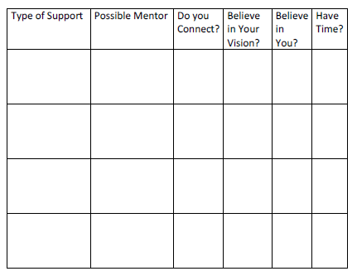
Worksheet
Grab your worksheet and follow along.

Slide 6

Type of Support

Slide 7

Possible Mentor

Slide 8

Do You Connect?

Slide 9

Do They Believe In Your Vision?

Slide 10

Do They Believe In You?

Slide 11

Do They Have Time?

Slide 12
How Does It Work?
Type of Support | Possible Mentor | Do you Connect? | Believe in Your Vision? | Believe in You? | Have Time?
Marketing Help | Mr. Roberts | Yes | Yes | Yes | Yes
Marketing Help | Mrs. Jones | No | Yes | Yes | Yes
Hiring Employees/ Interpersonal Skills Help | Mrs. Allen | Yes | Yes | Yes | No
Numbers Help | No one comes to mind | Not Applicable | N/A | N/A | N/A

Slide 13

Top Mistakes To Avoid
Deciding on a mentor too quickly.
Selecting a mentor that does not pass the checklist.
Having too many mentors.
Not asking a mentor to help you.
Thinking that it isn’t important to have a mentor.
Having only one mentor.
Not coming up with an agreement between you and the mentor.

Slide 14

Now What?
Figure out what you will benefit most from and find an appropriate mentor.
Tell your network of people, friends and family what kind of help you need.
Once you have found a mentor, build the relationship to make sure that you connect.
Ensure that there is a mutually beneficial reason to work together.
Ask the potential mentor if they would like to be your mentor.
Create a way to manage the relationship.

Slide 15

Key Points
Type of support
Possible mentor
Mentor criteria
Example
What not to do
Your next steps
Wrap up

Slide 16

The Goal
An action plan to getting a mentor.

Slide 17

Don’t be afraid to ask for help from others.

