Slide 1

Figuring Out Price
The price needs to be right!

Slide 2

Get it right the first time.

Slide 3

The Goal
Have a pricing strategy and a price specified.

Slide 4

Key Points
Minimum price
Maximum price
Your price
Pricing strategies
Example
What not to do
Your next steps
Wrap up

Slide 5

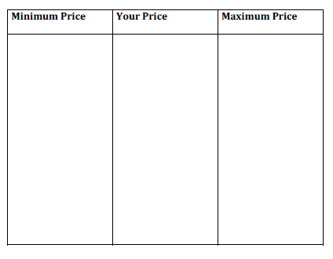
Worksheet
Grab your worksheet and follow along.

Slide 6

Key to Success

Slide 7

Minimum
Price

Slide 8

Maximum Price

Slide 9
Competitive Value
 | Perceived Value ($) | Price ($) | Benefit (Value minus Price) | Percentage Value (Difference divided by Value)
Competition
You

Slide 10

Your Price

Slide 11

Pricing Strategies

Slide 12
How Does It Work?
Competitive Value
 | Perceived Value ($) | Price ($) | Benefit (Value minus Price) | Percentage Value (Difference divided by Value)
Competition | 50 | 38 | 12 | 24%
You | 40 | 30 | 10 | 25%

Slide 13
How Does It Work?
Figuring Out Price
Minimum Price | Your Price | Maximum Price
$ 10/hr (Costs: gas, marketing) | $30/hr | $30.40/hour*

Slide 14

Top Mistakes To Avoid
Not thinking about the entire delivery
Not researching your costs.
Staying in the same price range as your competitor
Forgetting about substitute products
Assuming that you can change your price later
Underestimating your own value

Slide 15

Now What?
  Once you have come up with a price, test market it for validation
  Continue to analyze the competitive market place
  Monitor your prices

Slide 16

Key Points
Minimum price
Maximum price
Your price
Pricing strategies
Example
What not to do
Your next steps
Wrap up

Slide 17

The Goal
Have a pricing strategy and a price specified.

Slide 18

Take the time to think about your price point. It is one of your most important decisions.

