Slide 1

Credibility
How Do You View
Yourself?
How Do
Others?

Slide 2
Credibility Quiz
Are you not selling yet as you don’t have what is necessary to ‘be in business?’
Do you nervous when you mention you have your own business to friends?
When you say what you do, do people say “really?”
Some days you can’t believe you are in business!

Slide 3

The Goal
People buy from people that they trust. Build trust quicker.

Slide 4

Key Points
Inside
Outside
Example
What not to do
Your next steps
Wrap up

Slide 5

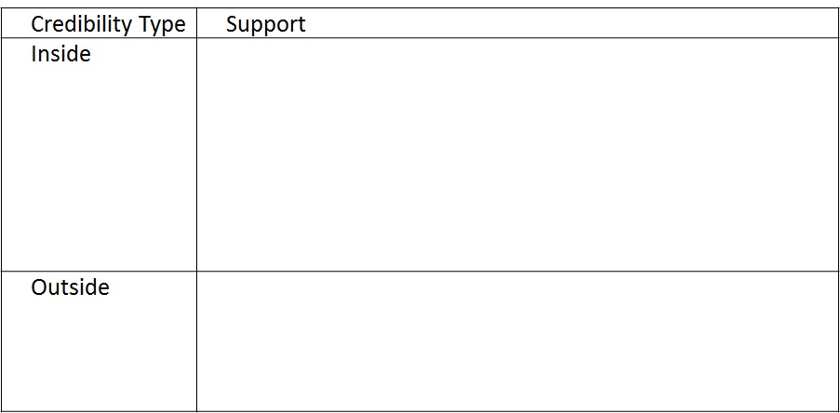
Worksheet
Grab your worksheet and follow along.

Slide 6
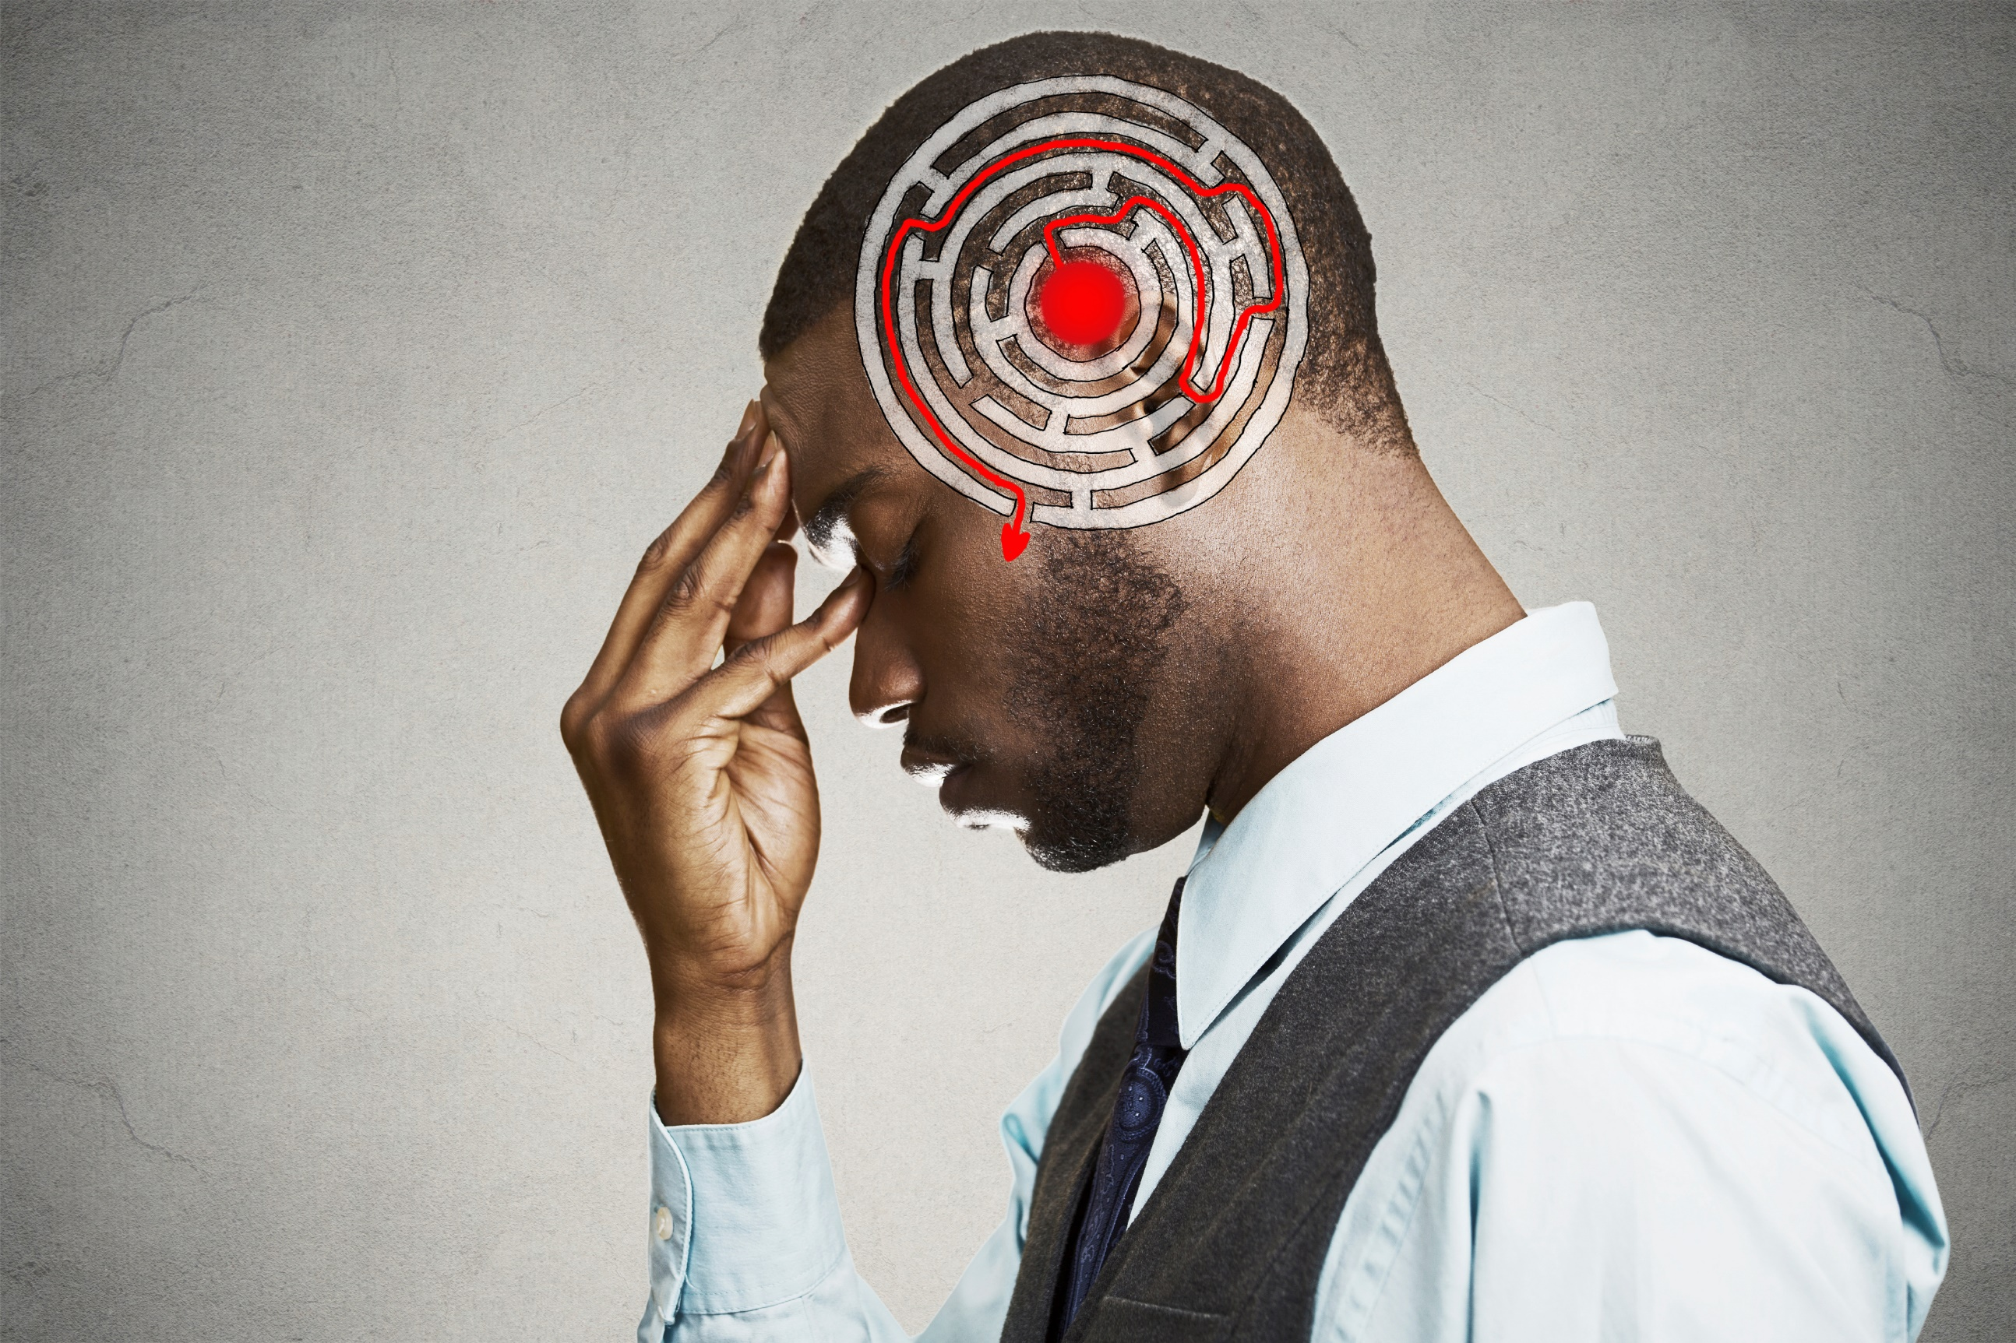
Inside
Celebrate wins
Reminder post-its
Get customer feedback
Competitive analysis
Write down your 20 benefits
Sell to family and friends first
Give away to test first

Slide 7

Outside
Business cards
Voicemail
Web presence
Referrals / Testimonials
Contracts / invoices
Seminars
Certifications
PO Box
1800#

Slide 8
Other Examples
Doctor – has his degrees hung up in the office
Restaurants – hang up their awards
New Cookie Brand – great packaging

Slide 9
How Does This Work?
Sam is starting a handyman company. For the last few years he has been charging neighbours and relatives to do some routine fix-it jobs around their homes, but has decided it’s time to commit to having his own business.

Slide 10
How Does This Work?
Credibility Type | Support
Inside | Start asking family and neighbours for feedback Do a competitive analysis to see what others do Offer any referral business a family/friends rate for the first 3 months
Outside | Make sure to have all necessary tools Get a business card Get an iPhone and record a professional voicemail message Download an iPhone credit card application to accept payments

Slide 11
Practice: Bookkeeper
You are a new bookkeeper who wants to begin doing the books of medium-sized businesses. You have an accounting degree but haven’t worked with you first customer and need to know how to prove to potential customers that you can do it.

Slide 12
Practice: Bookkeeper
Credibility Type | Support
Inside | Remind myself every morning that I can do this. Do first 2 customers at a reduced rate in order to learn the process. Get feedback from these customers. Ask them how much they would be willing to pay for this service normally. Try to understand with first two how much money you have saved them or how you have helped them. Remember this!
Outside | Put your designation on your business card. Have professionally done business cards, on good paper. Write up case studies regarding how you helped your first 2 clients. Dress in a suit whenever meeting a client.

Slide 13

Top Mistakes To Avoid
Not covering the basics first
Limiting business to family and friends
Trying to mask your own lack of confidence
Thinking that confidence remains steady

Slide 14

Now What?
Decide on 2 things to do this week to boost your own confidence
Review what you have done
Figure out where more effort needs to be put
Make a stranger a customer
Ask your customers how you are doing
Add more pieces of credibility
Double-check your own confidence & repeat

Slide 15

Key Points
Inside
Outside
Example
What not to do
Your next steps
Wrap up

Slide 16

The Goal
People buy from people that they trust. Build trust quicker.

Slide 17

Convince yourself first.

