Slide 1
Competitive Edge
If you don’t have an edge….
do you have a reason to be in business?

Slide 2
You Need An Edge!

Slide 3
The Goal
Create a bulletproof competitive edge.

Slide 4
Key Points
Acknowledge your biggest competitors
Understand where and how you have an edge over the competition
Example
What not to do
Your next steps
Wrap up

Slide 5
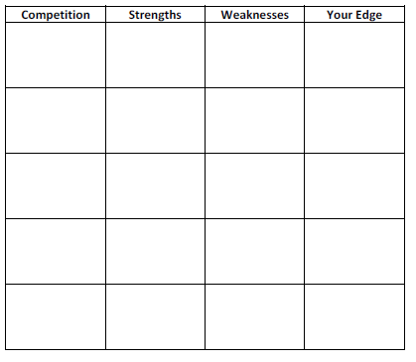
Worksheet
Grab your worksheet and follow along.

Slide 6
Competition

Slide 7
Strengths

Slide 8
Weaknesses

Slide 9
Competitive Edge

Slide 10
How Does It Work?
Competition | Strengths | Weaknesses | Your Edge
National and International Chain Grocery Stores | Largest selection of products and brands Cheapest prices | Do not adapt products to local target market Products travel long distances to shelf | Offer products that cater to the needs of the local community Offer fresher products
Large Local Grocery Stores | Good selection of products with local produce Offering of organic products | Some products travel long distances to shelf | Greater offering of organic products Work with local producers to offer local products
Independent Grocery Stores | Products adapted to local target market | Higher prices Limited product variety | Offer greater variety of products
Convenience (food & other products) Stores | Convenient locations and hours of operation | Highest prices Focus away from grocery products Smaller grocery selection | Offer lower prices Offer fresher products

Slide 11
Top Mistakes To Avoid
Trying to have multiple competitive edges.
Trying to be perfect at your competitive edge from the beginning.
Not continuing to monitor what is happening.
Not investing in continuous improvement.
Playing second to the competition.

Slide 12
Now What?
Figure out what your competition’s edge is.
Create your own competitive edge that is different than the competition.
Re-evaluate what you are doing and come up with ways to do it even better.

Slide 13
Key Points
Acknowledge your biggest competitors
Understand where and how you have an edge over the competition
Example
What not to do
Your next steps
Wrap up

Slide 14
The Goal
Create a bulletproof competitive edge.

Slide 15
Your competitive edge is the meat and potatoes of your business.
Everything else is gravy.

