Slide 1

Competitive
Analysis
Competition is
Everywhere!

Slide 2

What is Competition?

Slide 3

The Goal
Know where to look and what to look for.

Slide 4

Key Points
Acknowledge your biggest competitors
Understand where you stand versus your competitors
Example
What not to do
Your next steps
Wrap up

Slide 5

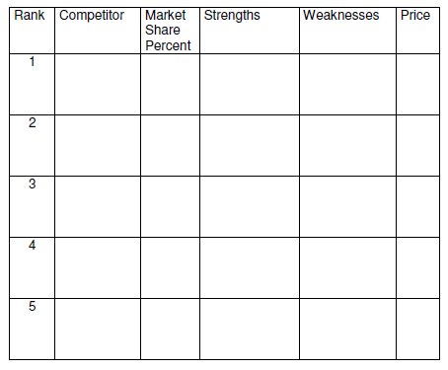
Worksheet
Grab your worksheet and follow along.

Slide 6


Slide 7
Competition
Substitutes
Indirect
Direct

Slide 8
Rank
1
Most Direct Competitor & Extremely Fierce
2
Direct Competitor But Slightly Less Fierce
5
4
3
Indirect, But Dangerous Competitor
Most Threatening Substitute
Average Direct Competitors

Slide 9
Market Share %
18%
53%
29%

Slide 10
Strengths & Weakness
Strengths
Weaknesses
What are they known for?
What would be the hardest for you to catch them on?
What do their customers talk about?
What do they do well?
What needs don’t they fill?
What do they do poorly?
What would be hard for them to change?
Where they have the most problems?

Slide 11
Price
Price A
A
A
Price B
B
B
B

Slide 12
How Does It Work?
 | Competitor | Mkt Share Percent | Strengths | Weaknesses | Price
1 | Nationwide Chain Coffee Shops | 50% | Large marketing budgets Standard products nationwide | Do not adapt to local market | Highest
2 | Other Local Independent Coffee Shops | 30% | Localized products | Higher input costs due to smaller buying power | Same
3 | Restaurants Serving Coffee and Tea | 15% | Consumers come for dinner and stay for coffee | Not first choice for consumers that want only coffee or quick service | Higher
4 | Coffee Shops in Neighboring Communities |  | Serve needs of their target communities | Consumers would need to drive to other communities | Same
5 | Consumers Drinking Coffee and Tea at Home |  | Cheap and convenient | Have to brew own drinks | Lower

Slide 13

Top Mistakes To Avoid
Pretending that you have no competition.
Not continuing to pay attention to the changing environment.
Not doing anything with the data once you’ve gathered it.
Ignoring your indirect competitors.
Ignoring your substitutes.

Slide 14

Now What?
Come up with a plan to increase your own strengths to combat the competition.
Mitigate your own weaknesses strategically and don’t waste your money.
Monitor your own market share versus your competition.
Continue to pay attention to the changing business environment.
Change your competitors when you should.
Develop your competitive edge once you have done the analysis.

Slide 15

Key Points
Acknowledge your biggest competitors
Understand where you stand versus your competitors
Example
What not to do
Your next steps
Wrap up

Slide 16

The Goal
Know where to look and what to look for.

Slide 17

Every business has competitors. Don’t ignore yours.

