Slide 1
Cash Flow Management
Cash is King.

Slide 2
Cash flow management is critical!

Slide 3
The Goal
Forecast of potential cash crunches.

Slide 4
Key Points
Timeframe
Cash In
Cash Out
Difference
Cash Balance
Example
What not to do
Your next steps
Wrap up

Slide 5
Worksheet
Grab your worksheet and follow along.

Slide 6
Cash flow impacts your business decisions.

Slide 7
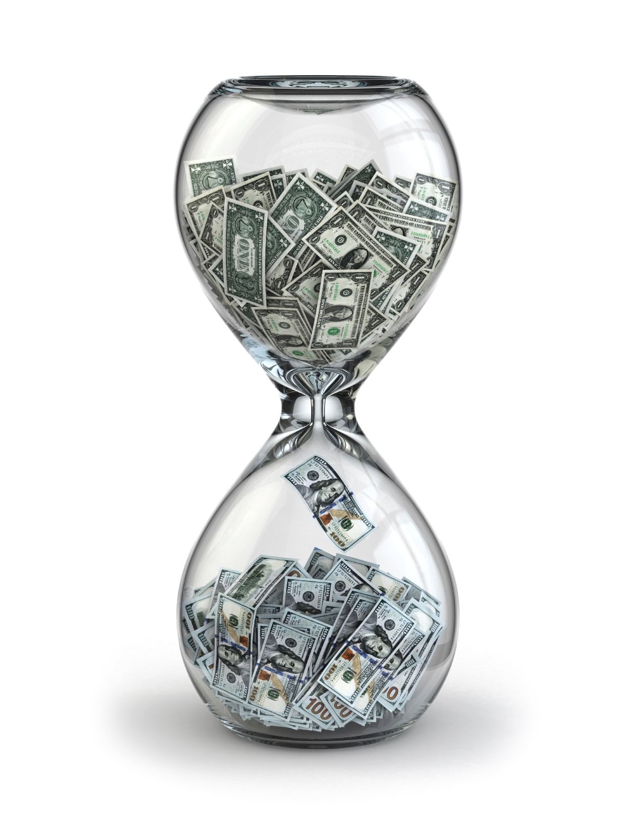
Timeframe

Slide 8
Cash In

Slide 9
Cash Out

Slide 10
Difference

Slide 11
Cash Balance

Slide 12
How Does It Work?
Timeframe | Cash In | Cash Out | Difference | Cash Balance
Next 30 days | $5000- Springfield | Materials-$3500 Tool Rental-$500 | $1000 | $0 (starting) + $1000 $1000
30-60 days |  | Tool Rental-$1000 Materials-$500 | -$1500 | - $500
60-90 days | $3000-Terrace $5500-Thompson | Tool Rental- $1500 Materials- $750 | $6250 | $5750

Slide 13
Top Mistakes To Avoid
Not keeping track
Not mitigating the cash going out
Not offering incentives to get more cash in
Not building relationships
Going out of business because of cash flow

Slide 14
Now What?
Don’t wait for the last minute
Plan strategically
In the long run you may see a trend of cash continuing to decrease
This model is just a starting point

Slide 15
Key Points
Timeframe
Cash In
Cash Out
Difference
Cash Balance
Example
What not to do
Your next steps
Wrap up

Slide 16
The Goal
Forecast of potential cash crunches.

Slide 17
You need to know how much cash you have to make decisions.

