Slide 1
Local Small Business marketing Plan
The Small Business Solver Team

Slide 2
Local marketing Works!
Local marketing works!

Slide 3
Build a local marketing plan that you can start using today.
Goal

Slide 4
What To Expect?
Marketing goal: ________________
Budget: $ _____________________
Target market: _________________
Message:
1. 2. 3.
Tools:
1. 2. 3.

Slide 5
Marketing Goal
How much will you increase…
# of customers
# of time customers come
Average amount spent
Overall revenue
Awareness levels

Slide 6
Budget
How much are you willing to spend to reach this goal?

Slide 7
Target markets
Who is this marketing campaign targeting?
Behaviours
What are they doing?
Values
Why are they doing those things?

Slide 8
Message
Focus on your audience
2 to 3 things
Simple
Ideas;
Business name
Product
What’s unique
Brand image
Logo

Slide 9
Tools
Cross promotions
Events / Open house
Sponsorships
Emails & loyalty
Volunteering
Google maps
Local directories

Slide 10
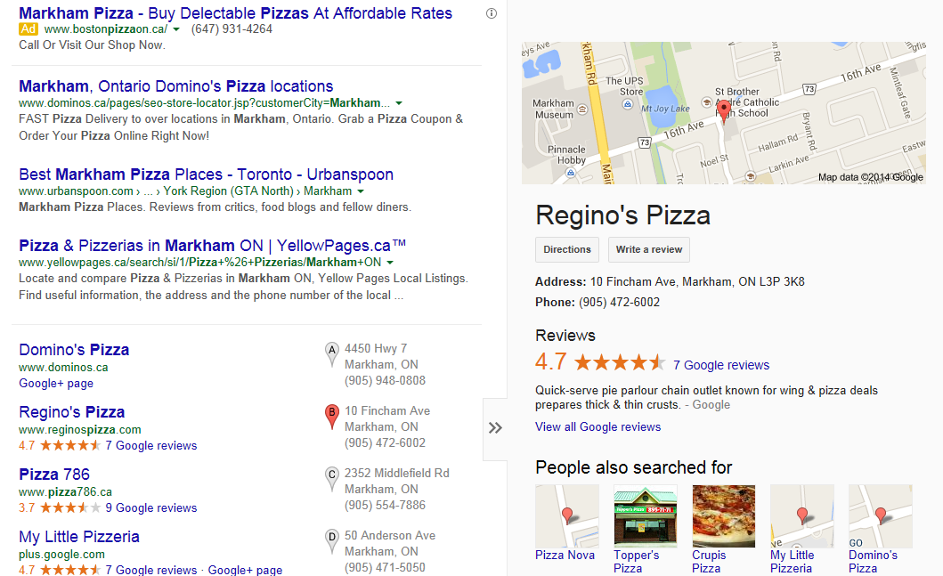
Google Maps & Local Directories

Slide 11
Tools
Community boards
Signage
Press releases
Flyers
Networking
Be Different

Slide 12
Wanda’s Wedding planning
Marketing goal: 3 new customers
Budget: $1000
Target market: busy brides
Message:
1. Wanda 2. easy wedding day 3. one stop
Tools:
1. Cross promos 2. Google Maps 3. Event w/ PR

Slide 13
Build a local marketing plan that you can start using today.
Goal

Slide 14
Local Small Business marketing Plan
The Small Business Solver Team

