Slide 1

How To Do A Quarterly Review? www.smallbusinesssolver.com

Slide 2
Quarterly Reviews Allow You to See The Forest.
Carla Langhorst
@business solver

Slide 3
What Will We Cover?
Why a quarterly review is critical?
Action planning recap
Steps to a quarterly review
Best practices
What not to do?

Slide 4
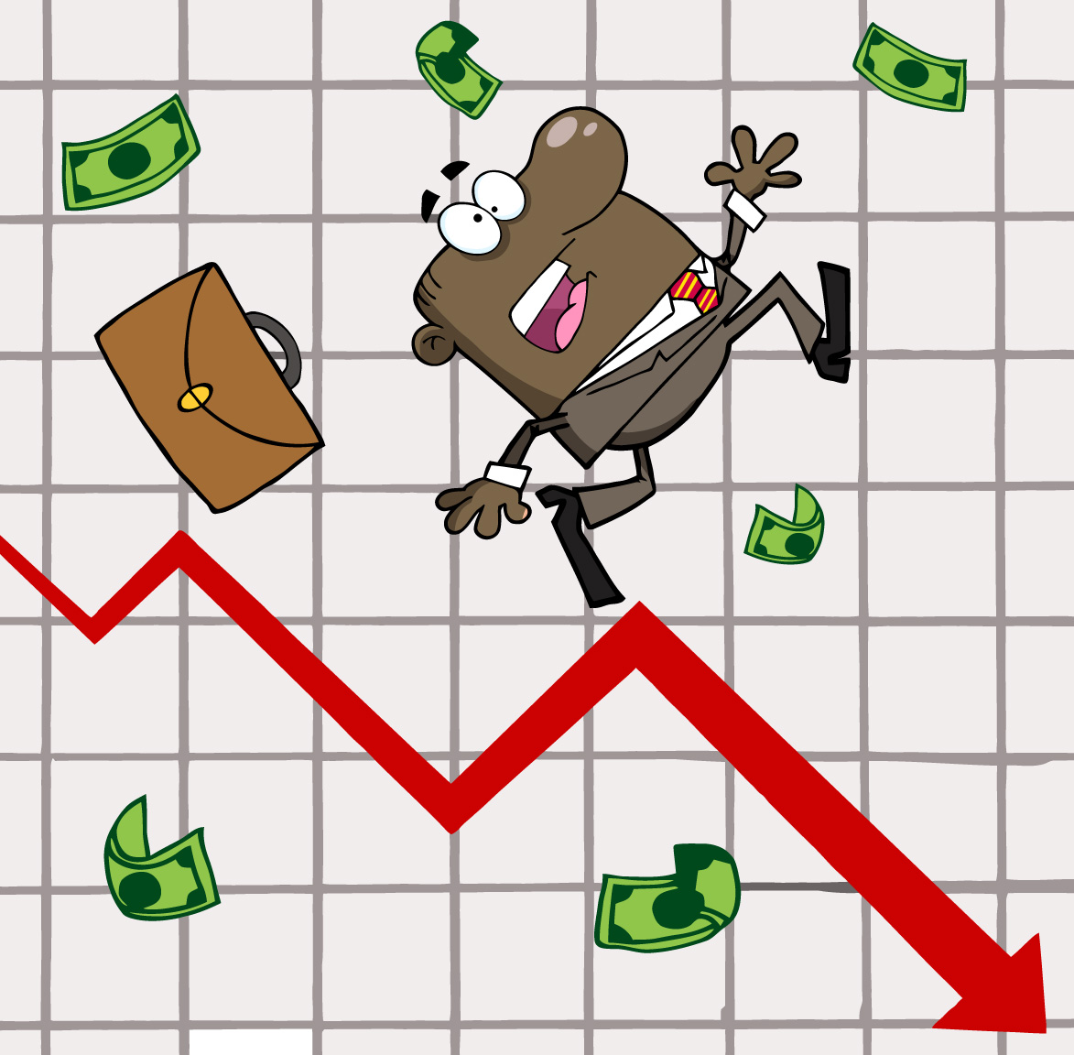
Why is a Quarterly review critical?
Dependent on YOUR ASSUMPTIONS.
And we all know what assumptions do…

Slide 5

Things Change!!
Are there new threats?
Are there new opportunities?

Slide 6

BHAG
< 3 years as a start up
< 5 years as small business
< 10 years as $1 billion business

Slide 7

Bites
Years
Quarters
Months
Weeks
Days

Slide 8
Steps To A quarterly Review
Internal Review
External
Review

Slide 9

Steps To A Quarterly Review
Internal Review
Where are we?
Where should we be?
Why the difference?

Slide 10

Steps To A Quarterly Review
External Review
Political review
Economic
Social
Technology
Competitive

Slide 11

Best practices
Involve stakeholders
Measure & monitor
Regular updates
Challenge assumptions
Have ownership
Stay committed
Align human resources
Target sales
Set milestones
Reward success

Slide 12

Top Strategic Implementation Mistakes
Just ignoring the plan
Lack of communication
Too tactical
Monitoring the wrong things
No measurement
Confusing

Slide 13
What Did We Cover?
Why a quarterly review is critical?
Action planning recap
Steps to a quarterly review
Best practices
What not to do?

Slide 14
Quarterly Reviews Allow You to See The Forest.
Carla Langhorst
@business solver

Slide 15
How To Do A Quarterly Review? www.smallbusinesssolver.com

