Slide 1

Making time for yourself
Contact Elise Mano at elisemano7@gmail.com

Slide 2

What if…?
Wasting time was good for your mental health?
Your assumption of productivity was wrong?
Down time was long forgotten thing of your childhood you just needed to relearn?
Imagine yourself enjoying your time off knowing full well you will be super charged with energy while working.

Slide 3
Recharge Your Battery
Sleep recharges our mind, body and soul to take on the life’s daily activities
However, our weekly schedules can be filled with too many activities. If we aren’t accomplishing something, we feel we are wasting time.
Therefore, by “Making Time for Yourself” you can create balance, increase productivity, and not feel guilty about enjoying your downtime.

Slide 4
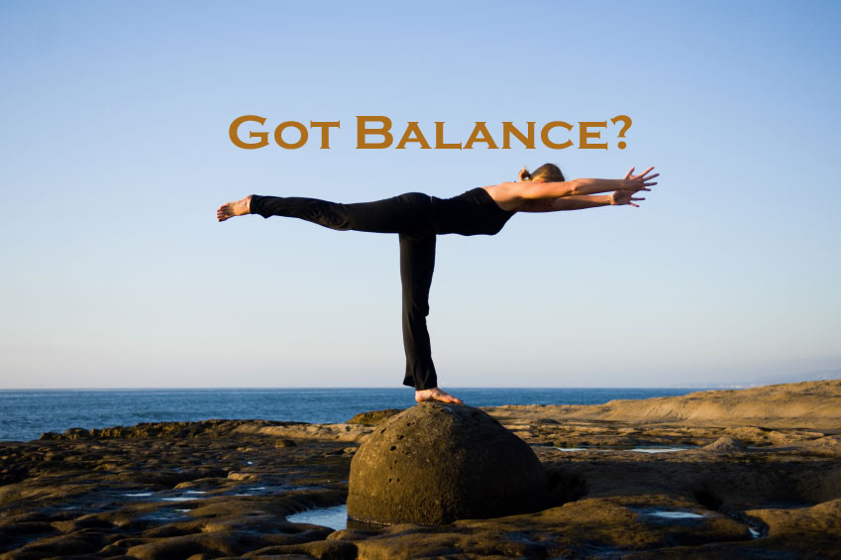
1. Balance
Where are you spending your time?
24 hours in a day
  Sleep 6-8 hrs
  Work 8 hrs (e.g. 9-5pm)
  8 hrs Free Time
Monday to Friday
  8 hours Free Time x 5 days = 40 hours
  40 hrs/wk x 4 wks = 160 hrs/month (approx. 1 week)

Slide 5
Balance
Family & Personal, Health and Fitness, Career, Financial, Adventure

Slide 6
Example
Being too busy and not having enough time is a sign of imbalance.
Priorities are shifted from Personal to Career/Financial.

Slide 7

Personal
Output:
Focused on external stimulation or relationships
Input:
Alone time
Why Energy In?
Inner growth and renewal
Most creative and inspiring when alone

Slide 8
Highest Level of Expertise
    Extremely talented people in many different disciplines: music, sports, writing
    4 hours a day early in the morning when mental and physical energy is readily available
    Restricting daily levels of practice allows for adequate rest and restore to equilibrium
    Individuals often encounter overtraining injuries and eventually “burnout”
    Psychologist K. Anders Ericsson (Florida State University)

Slide 9
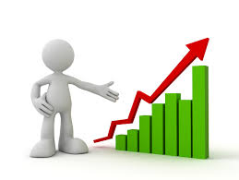
2. Increase Productivity
4 year study of work habits of employees at the Boston Consulting Group
  Encourage employees to take regular time off
    One day or night a week
  After 5 months:
    More satisfied with their job
    More likely to envision long-term future at the company
    More content with their work-life balance
    Prouder of their accomplishments
    Leslie Perlow of the Harvard Business School

Slide 10
Increased Productivity
Have you worked 50+ hours a week hoping to achieve greater results?
  In fact, leads to higher health and emotional costs
  If time is no longer available, what is?
The answer: Energy
  Enjoyment
  Level of engagement (e.g. willing to go above and beyond their basic duties)
  Tony Schwartz, CEO of The Energy Project

Slide 11
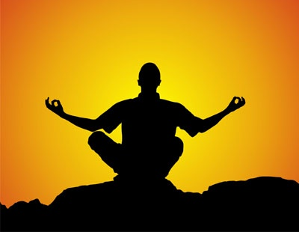
3. Downtime
Turning your attention away from the outside world toward your own mind
Meditation: taking time to sit in a quiet space, close their eyes
Mindfulness: focus on one’s thoughts, emotions, and sensations in the present moment
  Meditate daily
  Studies show 10-20mins
  of mindfulness a day is effective

Slide 12
Downtime
Ideas:
Play with kids
Schedule downtime
Creative: music, art, dance
Pursuing your passions/hobbies
Outdoors with Nature
Say No. Try not to take on more than you can handle
Be Idle for a weekend
Enjoy downtime
Slow down. Avoid multitasking
Take a walk

Slide 13
Conclusion
The challenge of making time for yourself
can be overcome by
focusing on your inner world
through
balance, increased productivity
and guilt free downtime.
Contact Elise Mano at elisemano7@gmail.com

