Slide 1
Social Entrepreneurship An Overview
Webinar – Small Business Solver
Norm Tasevski, Co-Founder and Partner
Venture Deli

Slide 2
Me

Slide 3
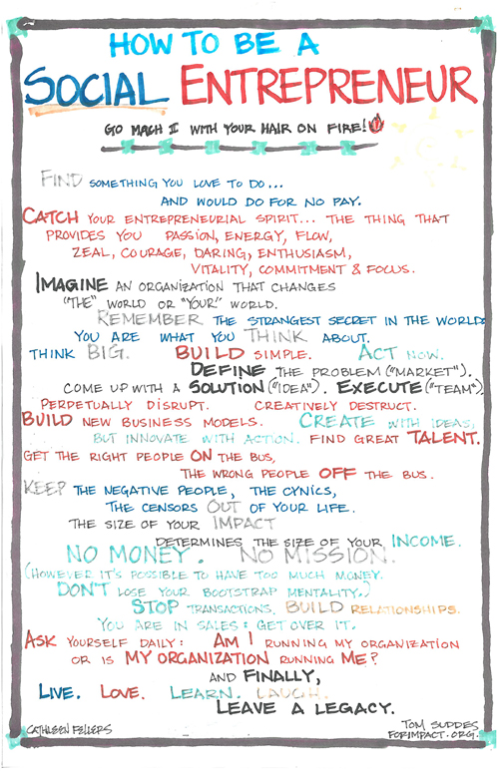

Slide 4
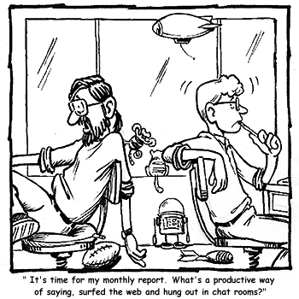
Understanding Social Entrepreneurship…

Slide 5
Definition
“A Social entrepreneur is someone who recognizes a social problem and uses entrepreneurial principles to organize, create and mange a social venture to make social change”
Wikipedia

Slide 6
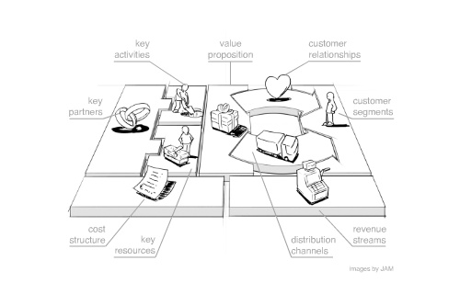
Another Definition

Slide 7
Distinguishing Entrepreneurship from “Social Entrepreneurship”
Motive
Intent
Permanence

Slide 9
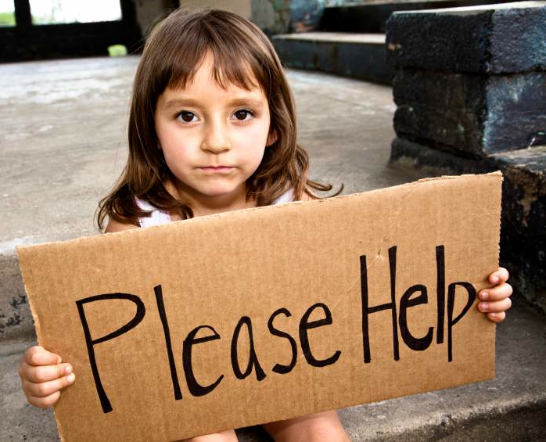
Motive?
Or

Slide 10
Intent

Slide 11
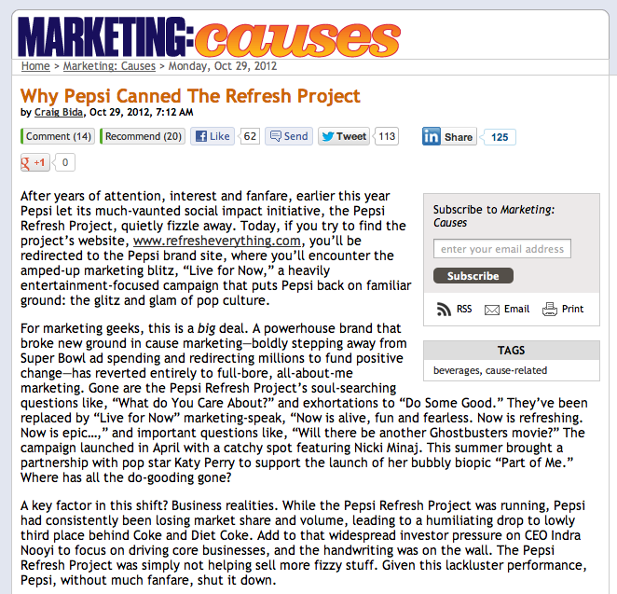
Permanence

Slide 12
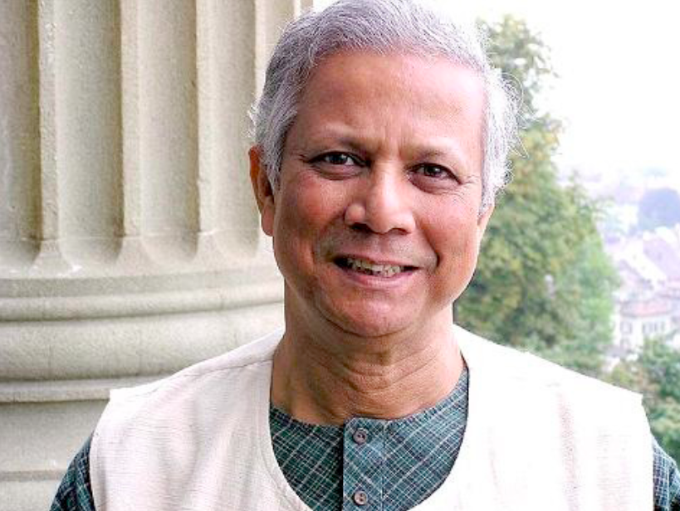

Slide 13
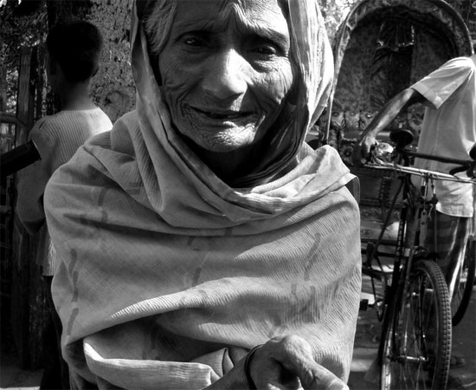
Motive

Slide 14
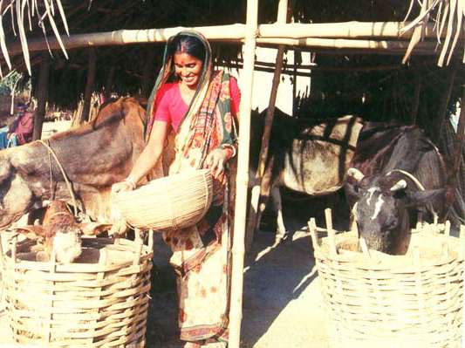
Intent

Slide 15
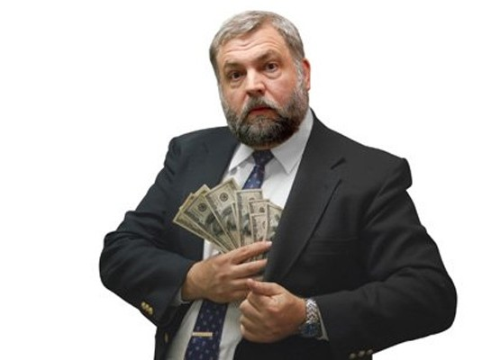
Permanence
X

Slide 16
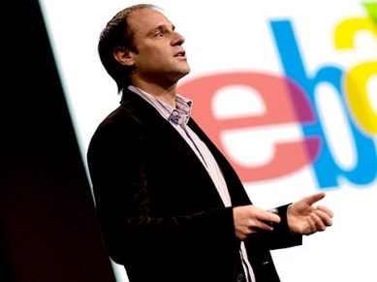
What Motivates the Social Entrepreneur
“…it was an epiphanal experience…”
Ray Anderson, Interface Carpets
“I heard the same story again and again. Someone had experienced an intense kind of pain that branded them in some way. They said, ‘I had’ to do this. There was nothing else I could do.”
Jody Jensen, Ashoka
“I was teaching in one of the universities while the country was suffering from a severe famine. People were dying of hunger, and I felt very helpless. As an economist, I had no tool in my toolbox to fix that kind of situation.”
Mohammed Yunus, Grameen Bank
“…that made a real impression on me…”
Jeff Skoll, eBay, Skoll Foundation, etc.

Slide 17
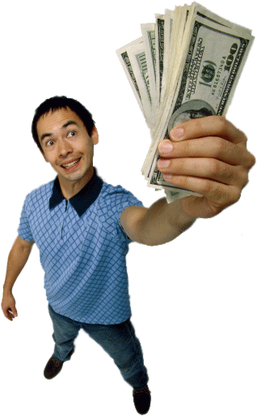
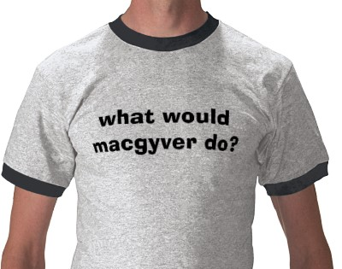
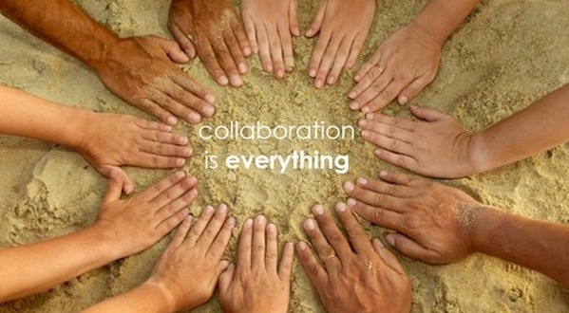
Distinguishing Entrepreneurship from “Social Entrepreneurship”
Key Differences
Motivation
Innovation
Resourcefulness
Risk Taking
Traditional Entrepreneurship
Social Entrepreneurship
From “money” to “community”
From “building a product” to “building resiliency”
From “competition” to “collaboration”
From “financial” to “unreasonable”

Slide 18
Other Differences
“Social entrepreneurs are not content just to give a fish or how to teach fish. They will not rest until they have revolutionized the fishing industry”
Bill Drayton
Focus on “systems thinking” and “systems change”:
“(Social entrepreneurs) work in areas where there is partial or total market failure…what distinguishes them is that they are prepared to strike a very different balance when it comes to creating value for those who would not normally be able to afford it”
John Elkington
Seek “profit” in traditionally unprofitable pursuits:
David Bornstein: “Why do you work on the kinds of projects you do? Why don’t you just want to make a lot of money?”
Fabio Rosa: “I am trying to build a little part of the world in which I would like to live. A project only makes sense to me when it proves useful to make people happier and the environment more respected, and when it represents a hope for a better future. This is the soul of my projects.”
Possess a strong “ethical impetus”:

Slide 19
Understanding Social Enterprise…

Slide 20
1. Product-Based
A business/business model that provides
products or services with social benefit.

Slide 21
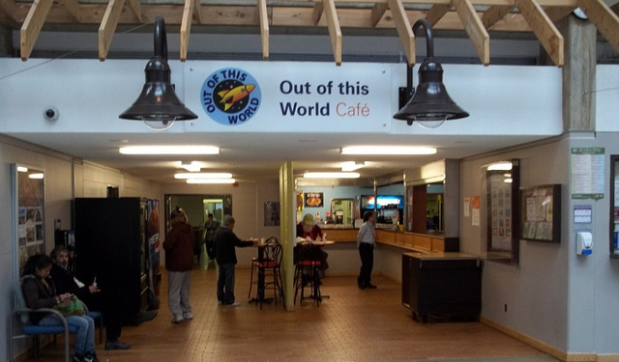
2. Employment-Based
A business that hires marginalized people
in good employment opportunities.

Slide 22
3. Accessibility-Based
A business that maintains a purposely low profit margin
to make their products accessible.

Slide 23
4. Tethered
An enterprise started by a charity or non-profit that generates revenue for the organization.

Slide 24
A Test…
I am:
A retailer
Sells goods at rates affordable by low-income individuals
Employs individuals with barriers to employment
Goals:
92% of imported goods from green factories
95% of waste redirected from landfill
Desire to be supplied 100% by renewable energy by 2015
Facts:
$115M raised for charity since 1995 ($18M in 2009)
Over 1,000 environmentally-approved products on sale
1700 new jobs created in Canada in 2009
Social Enterprise or Not?
Notes:
Is Walmart a social enterprise – reason for, reason against
Goal – to distinguish SE from CSR, charity, etc

Slide 25
A Test…
I am:
A café
84% of all coffee ethically sourced (goal of 100% by 2015)
Supports farmers by a) selling fair trade coffee, and b) providing loans to coffee growers
Purchase carbon credits to offset production
Goals:
100% of cups to be reusable/recyclable
Use recycled/renewable materials in café construction
Organize a “month of service” (employees act as “change makers” in their communities)
Social Enterprise or Not?
Facts:
Sells approx. 10% of all Fair Trade coffee globally
Almost 200,000 volunteer hours made by employees worldwide
Over 53,000 youth supported and engaged in community events
Notes:
Is Starbucks a social enterprise – reason for, reason against
Goal – to distinguish SE from CSR, charity, etc

Slide 26
What “Social Enterprise” is and is not…
Social Enterprise Is Not… | Social Enterprise Is…
A fundraising strategy (i.e. a “give” mentality) | A business line (i.e. a “sales” mentality)
Dependent on restricted funds for operations (i.e. not sustainable) | Sustainable (ideally “self-sufficient”)
An event or one-off activity (e.g. conferences, bake sales) | A continuous, market-driven activity
Providing value to clients only | Providing value to both “clients” and “customers” (and distinguishing between both!)
Quick | A venture that may take several years to become profitable/sustainable

Slide 27
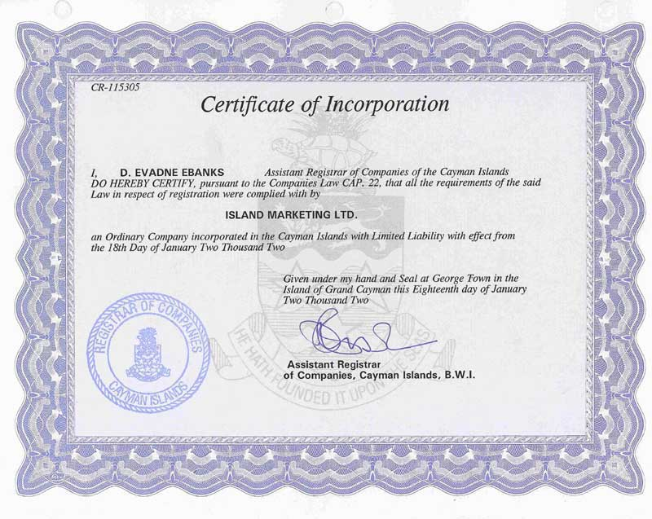
Distinguishing Traditional Business from “Social Enterprise”
Key Differences
A goal
A Product/ Service
A Transaction
A Legal Form
Traditional Business
Customers
Social Enterprise
Customers
+
“Clients”
“Blended Value”
Infuse “Social Benefit” in the Value Chain
There is no “SE Legal Form”
Customers + Clients

Slide 28
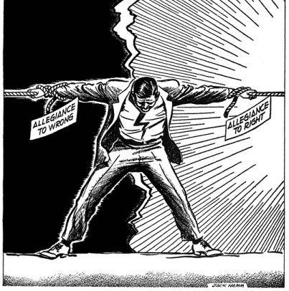

Slide 29
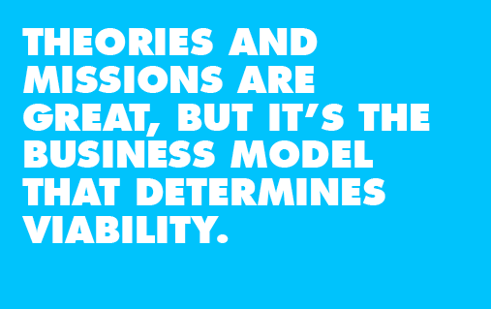

Slide 30
Opportunity Assessment: Step 1
Find a “pain” point!! – Everything Relies on This
“Pain”:
A need for a product or service that isn’t adequately satisfied by competitors or other substitutes
Tip: Focus on “pain first, product second”
The general tendency of social enterprise is to focus on “product first, pain second”

Slide 31
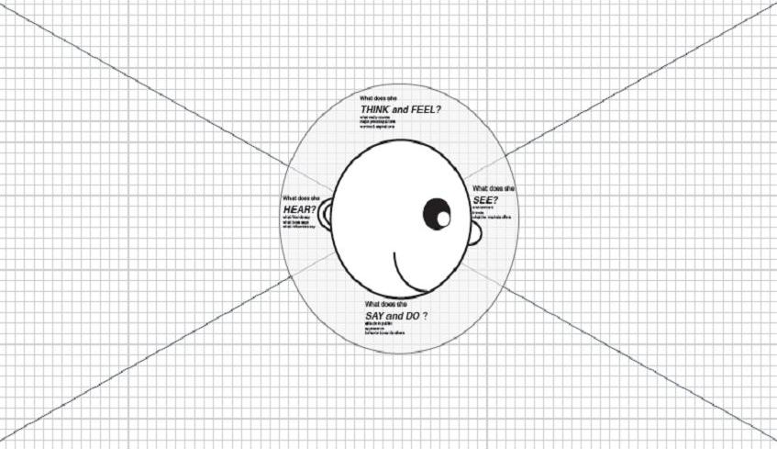
Opportunity Assessment: Step 1
How do you ID customer pain?
Empathy Mapping

Slide 32
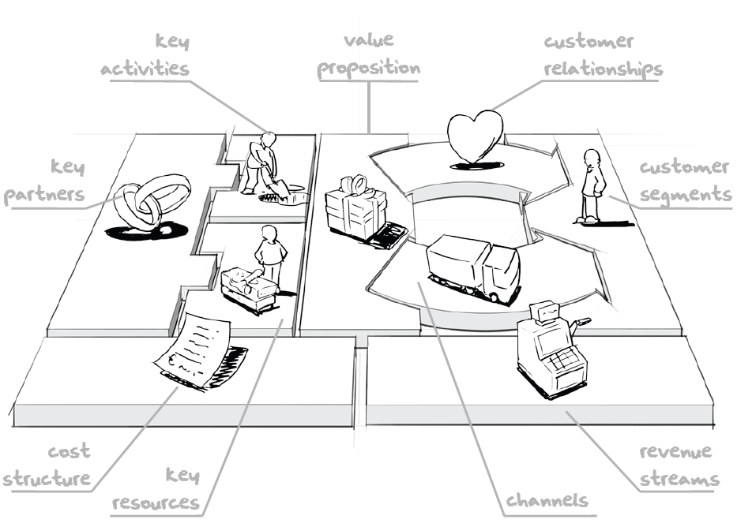
Opportunity Assessment: Step 2
Determine a business/revenue model!
Business Model Canvas

Slide 33
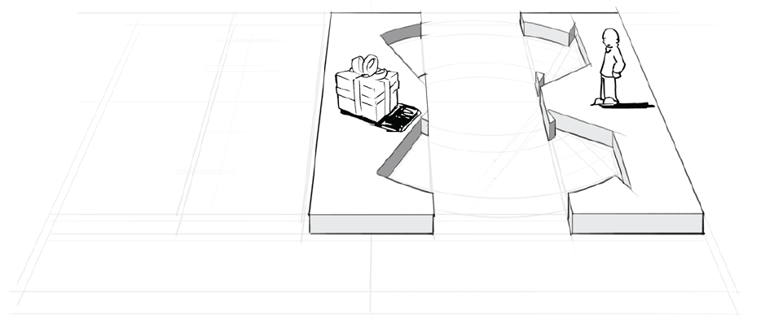
Opportunity Assessment: Step 2
Components of a Business Model
Customers
Do they have an unsatisfied pain point?
Are they willing to pay?
Are there enough of them?
The Offer
What value are you creating?
Does it alleviate customer pain?
Is it compelling?
Channels and Relationships
How does the customer receive the offer? (physical movement of the product)
What is the interaction between you and the customer? (the movement of information)

Slide 34
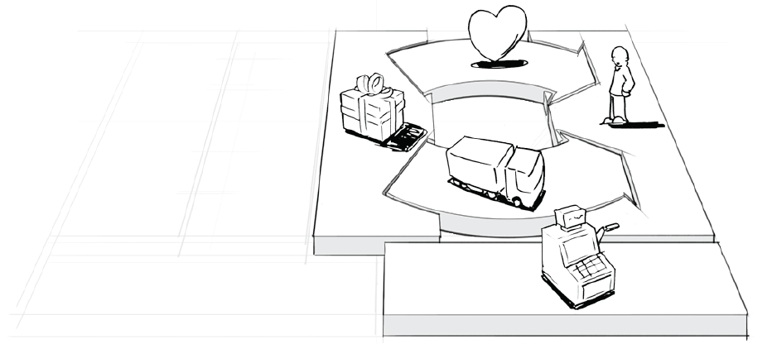
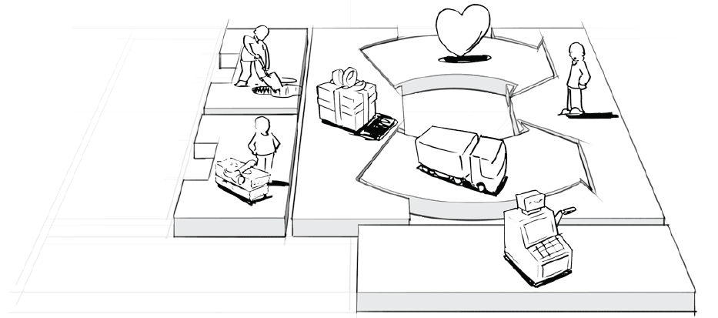
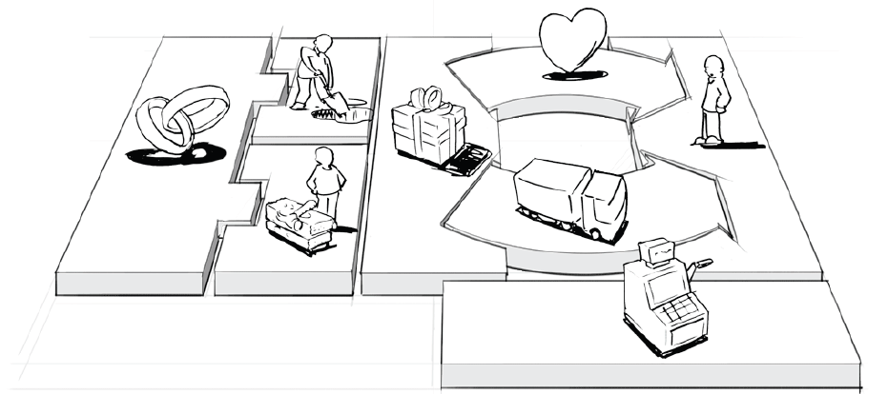
Opportunity Assessment: Step 2
Components of a Business Model
Revenue Streams and Cost Structure
How does cash flow into the company?
How does cash flow out of the business?
What is your pricing model?
Key Resources and Key Activities
What are your assets (human, physical, intellectual)?
What activities do you plan to undertake to generate value?
Key Partners
What partners are integral to enable the launch and operation of the business?

Slide 35
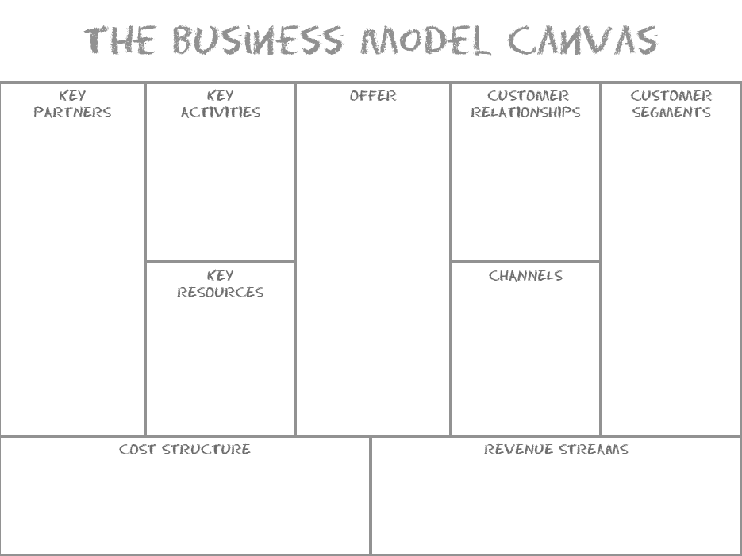
-Coffee roasting/brewing
-Processing orders
-Personal (Baristas)
-Online, print ads
-Coffee
-Food
-Merchandise
-Farmers
-Suppliers
-Adults that want a place to relax, work quietly, meet friends, etc
-Locations
-Coffee making equipment
-Baristas
-Coffee shops
-Kiosks
-Staff training
-Asset acquisition
-Marketing
-In-store Purchases

Slide 36
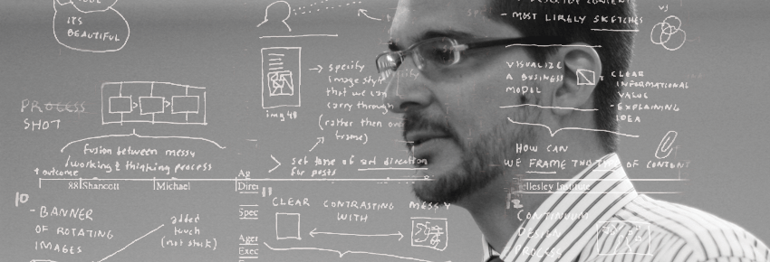
Tip…
Be a Business Model “Alchemist” – You need to go through the business model process many times in order to figure out which model best fits

Slide 37
Are you Ready to Start a Social Enterprise?

Slide 38
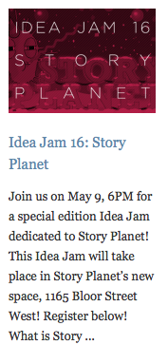
Identify “Readiness” for SE
“Idea Jams”
A technique for:
Brainstorming social enterprise ideas
Brainstorming how social enterprise “fits” with your congregation
Steps:
Arrange participants in “teams”. Each team identifies a “seed” of an idea (Example: “members of our congregation are artists – can we turn this into a social enterprise?”)
The team then brainstorms on how to make the seed idea a reality. Brainstorming lasts 30-40 minutes
After a short break, the teams dissolve and new teams are arranged. The new teams then re-brainstorm on the work done prior to the break
Brainstormed ideas are then reviewed as a full group
Set up: arrange tables and place flip charts and markers on tables to brainstorm on. Make the brainstorming visual!

Slide 39
Identify “Readiness” for SE
Complete the following Checklist:
How do you plan generate income in the social enterprise?
Will you sell a product or a service?
How do you plan to capitalize the social enterprise?
Does the business align itself to equity/debt/philanthropic capital?
What terms do you need to see in the investment?
What is your risk tolerance?
Are you willing to take a loss for 1-2 years before profitability?
How much flexibility do you need?
Do you need independence in decision making/target setting?

Slide 40
Identify “Readiness” for SE
Do you have entrepreneurial “zeal”?

Slide 41
Thank You
Norm Tasevski, Co-Founder and Partner
Venture Deli

